Slide 1
Get The Whole Story
GACVB
February 4, 2025
Notes:
Presented by Jim Harenchar, President & CEO of Response Marketing Group at the GACVB 2025 Conference.
Don’t know where to start? Not sure you have the right data to achieve your goals? RMG is offering a free 30-minute consulting session to discuss your 2025 priorities.
If you'd like to dive deeper, book a time with us.
Jim Harenchar Melissa Lewis
804-370-1439 843-330-8746
jharenchar@rmg-usa.com mlewis@rmg-usa.com

Slide 2
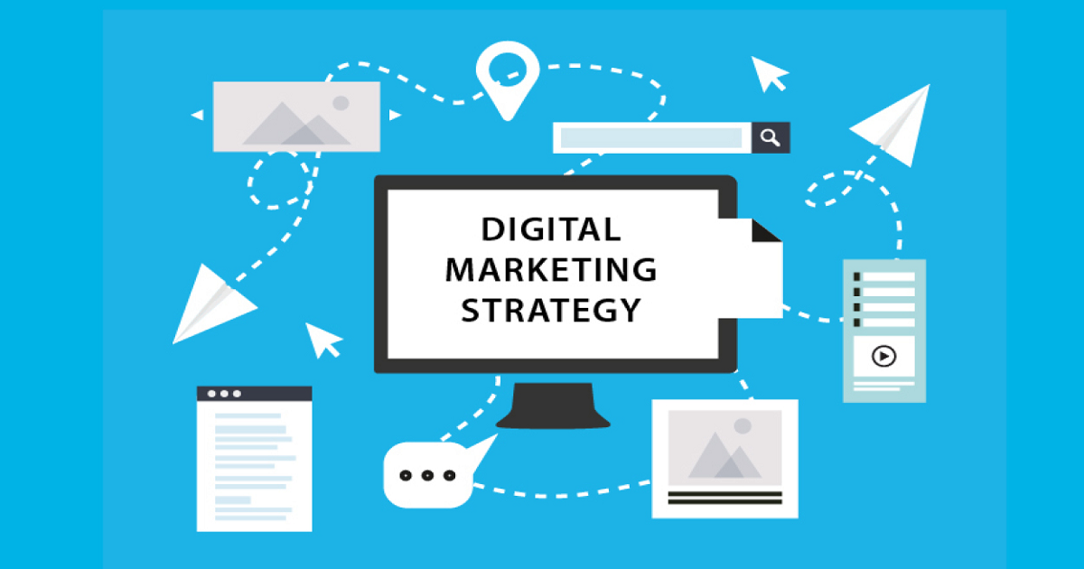
Data … A Foundation For Marketing Success
Notes:
Everyone agrees, the volume of data available to us today as marketers is overwhelming. What do you need, what is not important? How should I store my data and what sources do I have to get data? Let’s answer all of these questions today.

Slide 3
From the dawn of civilization until 2003, humankind generated five Exabytes of data.
Now we produce five Exabytes every two days…and the pace is
accelerating.
Eric Schmidt,
Executive Chairman
Google
Notes:
According to Eric Schmidt of Google…

Slide 4
Exabytes?
Megabyte | Gigabyte | Terabyte | Petabyte | Exabyte
1,000,000 bytes | 1,000,000,000 bytes | 1,000,000,000,000 bytes | 1,000,000,000,000,000 bytes | 1,000,000,000,000,000,000 bytes
5 Megabytes = the complete works of Shakespeare OR 30 seconds of TV-quality video | 50 Gigabytes = a floor of books OR hundreds of 9-track tapes | 10 Terabytes = the printed collection of the US Library of Congress | 2 Petabytes = all US academic research libraries | 5 Exabytes = all words ever spoken and written by human beings
Notes:
That sounds like a LOT of data. And in case you’re wondering whether size matters…

Slide 5
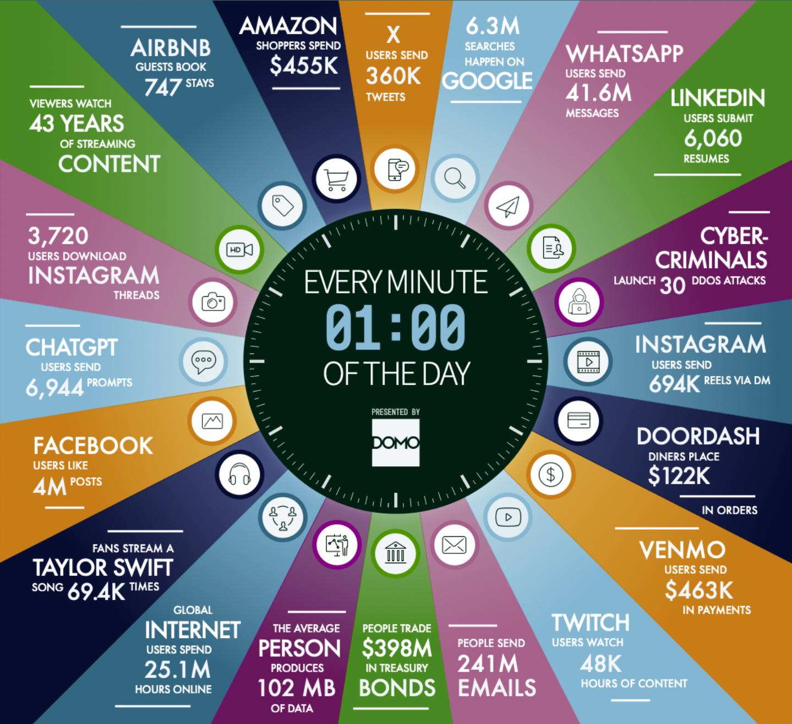
Data … The New Commodity
Notes:
With the proliferation of social platforms and the levels of engagement, the data created is overwhelming. For a few examples of what occurs every minute of every day, here are a few examples: you can see just how many Instagrams are posted via DM, there are 4 million Facebook posts and over 69,000 Taylor Swift songs streamed!

Slide 6
Data … The New Commodity
Data is like gold to a marketer.
Yet 76%* of tourism marketers don’t make use of data in their online marketing and targeting.
Using visitor data, marketers can
Target individuals
Build customer segments & profiles
Serve most relevant ads
Maximize profits
Increase the efficiency of an ad campaign
*McKinsey Consulting
Notes:
In 2024 McKinsey Consulting surveyed Fortune 1000 senior marketers. They found that despite the recognition that data was mission critical to marketing success, 76% of tourism practitioners don’t use data in their online marketing and targeting.

Slide 7
Data … Driving ROAS Measurement
Online sales poised to constitute 76% of total revenue of the travel and tourism market by 2028
35% of people find new travel destinations on Instagram
69.8% of people use search engines to plan their travel, and 36.5% use social media for travel ideas
Referral marketing has an average conversion rate of 9.5%
30% of travel marketers see Facebook as the most effective way to target new audiences and 28% of them say the same for Instagram
Notes:
As we move into 2025, it’s important to know just how much our audiences are using various platforms to research and book their next destination.

Slide 8
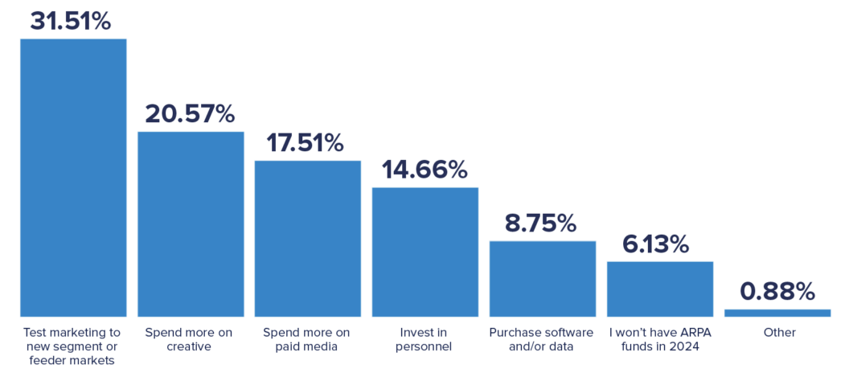
Data . . . Driving ROAS Measurement
How are DMO marketers planning to allocate paid media resources in 2024?
Notes:
This survey was conducted by Advanced Travel and Tourism in 2024 and underscores the disconnect by many of us as it relates to our investment of time and money in using data. Many DMO marketers (21%) said they were going to invest more in creative but only 9% were going to invest in software or data. What and who are you targeting with your 21% increase in creative if you don’t use data to guide your process?

Slide 9
Data & AdTech
Notes:
Data & AdTech

Slide 10
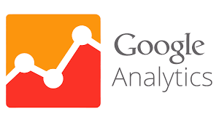
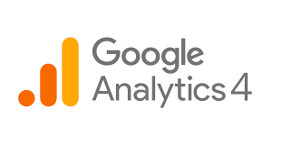
Birth Of Campaign Measurement?
Notes:
In 2005, Google launched their Analytics offering. While that product has become the default measurement tool for many in our industry, it’s 20 years old!

Slide 11
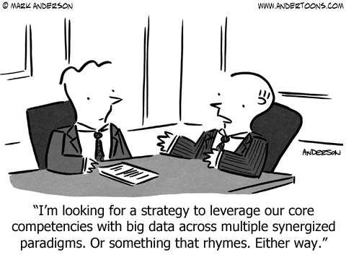
Notes:
“I’m looking for a strategy to leverage our core competencies with big data across multiple syngergized paradigms. Or something that rhymes. Either way.”

Slide 12
Tourism AdTech Landscape
Notes:
Over the last 3-4 years we’ve seen a variety of tech and data-focused specialists enter the tourism space to offer better products and services to help DMO marketers.

Slide 13
Building A Data Foundation
Customer Insight Drives Relevance And Response
Advanced personalization tactics drive 17% more revenue per booking.
The time between customers signaling interest and booking is as little as 4-48 hours.
Reducing website form submissions to just name and phone or email can lift response by 200%.
Eliminating unqualified or fraudulent leads and inquiries can save more than 20% in operating costs.
Prioritizing qualified Group leads can increase conversions by 25% or more.
Most DMO data files contain 40% “dirty” records.
Notes:
These data-focused providers offer the ability to help DMO marketers better focus their precious budget on those areas they can measure and improve.

Slide 14
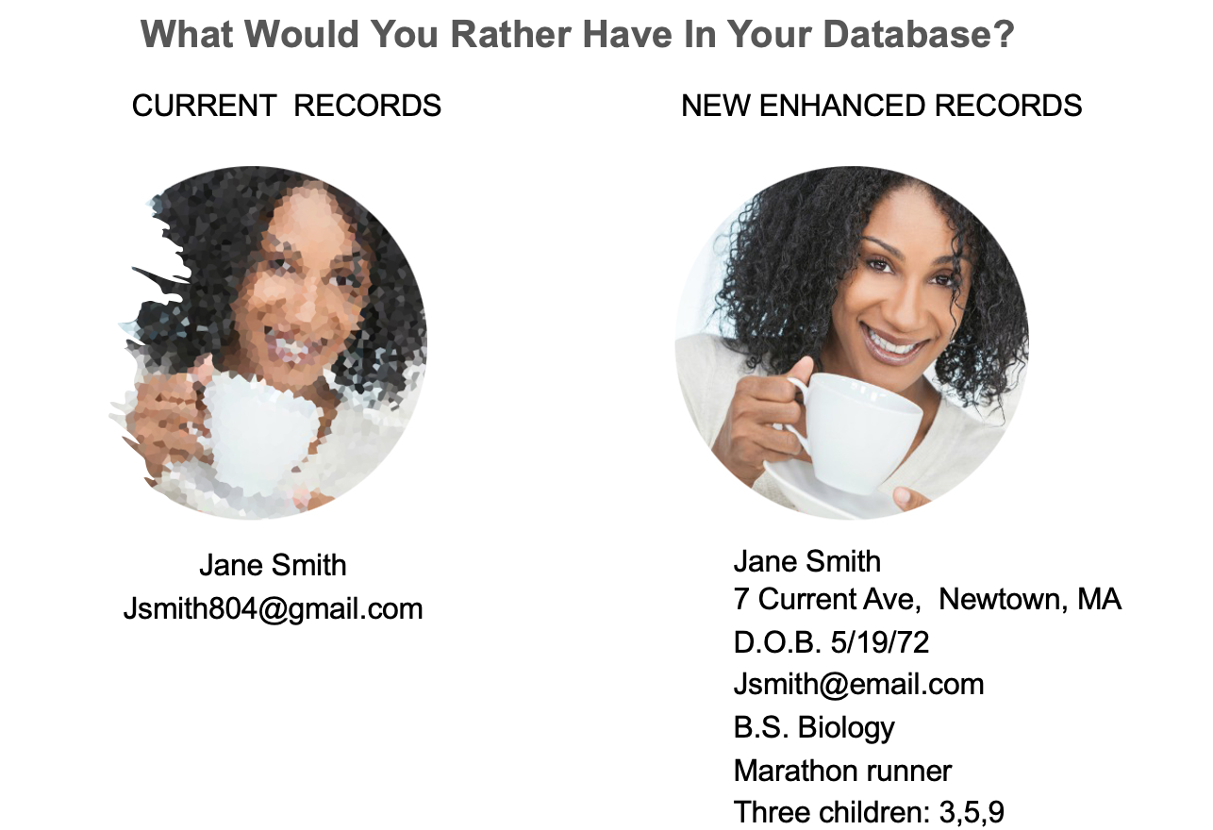
Building A Data Foundation
Notes:
Logic tells us that having more information on our inquirers and visitors only allows us to increase engagement, occupancy and referrals. Knowing more about “Jane Smith” will help us better target and deliver relevant messaging.

Slide 15
Building A Foundation
Data Acquisition
Publicly Available Data,
CCPA and GDPR Compliant
Property records
Tax records
County/City records
Registrations
Warranty Cards
Surveys
Email Opt-in
Mail Responders
Donations
DMV
Subscriptions
Purchase Behavior
USPS/NCOA
Household/Individual Records
Notes:
Most DMO marketers don’t fully realize just how much public information is available for purchase from data providers. For a small investment, you can acquire data from these sources that includes insightful information on your inquirers.

Slide 16
Building A Foundation
Data Enhancement
300 Key Demographics and Psychographic Data Variables
City, County
Age
Gender
Marital Status
Income
Net Worth
Presence of Children, Ages
Behavioral Interests
Ethnicity
Primary Language
Notes:
Once you have data, or to keep your data “fresh”, there are hundreds of list vendors and data sources that resell demographic and psychographic information to enrich your visitor/inquirer files.

Slide 17
Building A Data Foundation
Where’s The Opportunity?
Visitor Center Walk-Ups
Online Info requests
Inbound Phone Calls
Lodging Partner Inquiries, Reservations, Stay Data
Dining/Retail/Attraction Partners
Sports Tourism Inquiries & Visitors
Events, Festivals, Concerts
Marketing Campaign Responders
Opens/clicks/views/likes/comments
Influencers
SMS/text
Notes:
Many ask where they can capture inquirer and visitor data. This is just a short list of lead sources you may be overlooking or have failed to consider.

Slide 18
Building A Foundation
Gather Audience Insights
Who is coming to your website and visiting in-person?
How often?
What kind of behavior are they demonstrating?
Collect and Monetize Audience Data
What visitor and inquirer data have you collected over the past 5+ years?
What do you HAVE and what do you NOT HAVE?
How can you use that data to improve your marketing effectiveness and increase engagement?
Notes:
As you think about your 2025 planning, setting goals to better capture inquirer and visitor information should be at the top of your list.

Slide 19
Building A Foundation
What Channels Are You Using & Measuring?
Managing advertisements across channels:
Search (SEO/SEM)
Display
Video/CTV/OOH
Mobile/SMS/Text
Email
Social (Facebook, Instagram, TikTok)
You should be demanding hard data on the ads you deploy!
Which ads/channels generate the highest yield?
Which type of ad/channel is most successful?
Which channel partners allow you to monetize your data best?
Notes:
Consider EVERY channel you are or have used in your marketing outreach and make it intentional to collect more data in 2025.
Also, hold your agency and media partners accountable for measurement. Ask the tough questions and demand transparency – what’s working and what’s not?!

Slide 20
Building A Foundation
“Digital Shoebox”
CRM
Notes:
Whether you have a “Digital Shoebox” of simply names and Excel spreadsheets or an advanced CRM capturing all of your leads and results, don’t let 2025 be another year of failing to leverage your data.

Slide 21
Data Insights In Use
Notes:
However, Big Data applied to marketing provides the ability to better understand customers, in real time and on a vast scale. At The Ritz Carlton we used past guest data to build customer segments to better align creative and copy with the most relevant segments.

Slide 22
The Ritz Carlton
1
DEVELOP A CUSTOMER-CENTRIC COMMUNICATIONS PLAN
2
USE DATA/SEGMENTATION TO CREATE RELEVANCE
3
BUILD AND ENHANCE A PROACTIVE DATA - DRIVEN CADENCE
4
IMPROVE TARGETING BY APPLYING DATA-DRIVEN MARKETING
Notes:
However, Big Data applied to marketing provides the ability to better understand customers, in real time and on a vast scale. At The Ritz Carlton we used past guest data to build customer segments to better align creative and copy with the most relevant segments.

Slide 23
The Ritz Carlton
Lower Frequency of Travel
Higher Frequency of Travel
ENGAGE,
PROTECT
More Luxury
Well-Traveled
Executives
BUSINESS & LEISURE
Sun
Seekers
Savvy
Optimizers
The
Celebrators
The
Aspirers
REWARDS
EMPHASIS
Occasional
Explorers
Less Luxury
STIMULATE
Notes:
We found that 3 of their most important segments had very distinct booking windows, from 60 days to 11 months.

Slide 24
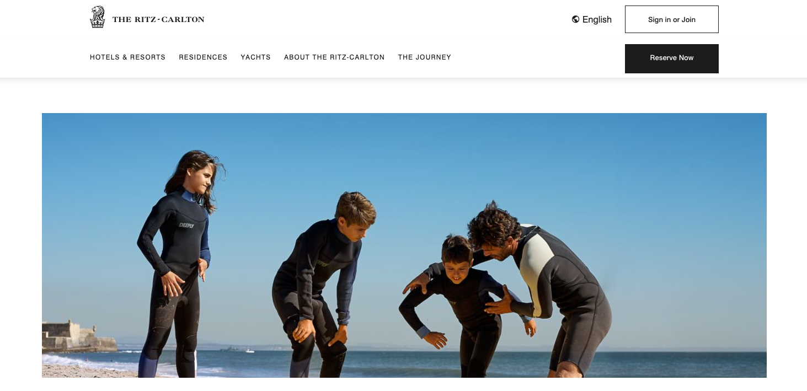
The Ritz Carlton
CTR/OPEN
Engagement
Booking Revenue
12% - 32%
30%-65%
10%-45%
Notes:
Creating segments and images that resonated with the target audience led to significant increases in open rates, engagement and bookings.

Slide 25
Anonymous & De-Anonymized Data
Notes:
As you finalize your 2025 marketing data planning, there are 2 types of data that can impact your success: Anonymous and De-Anonymized.

Slide 26
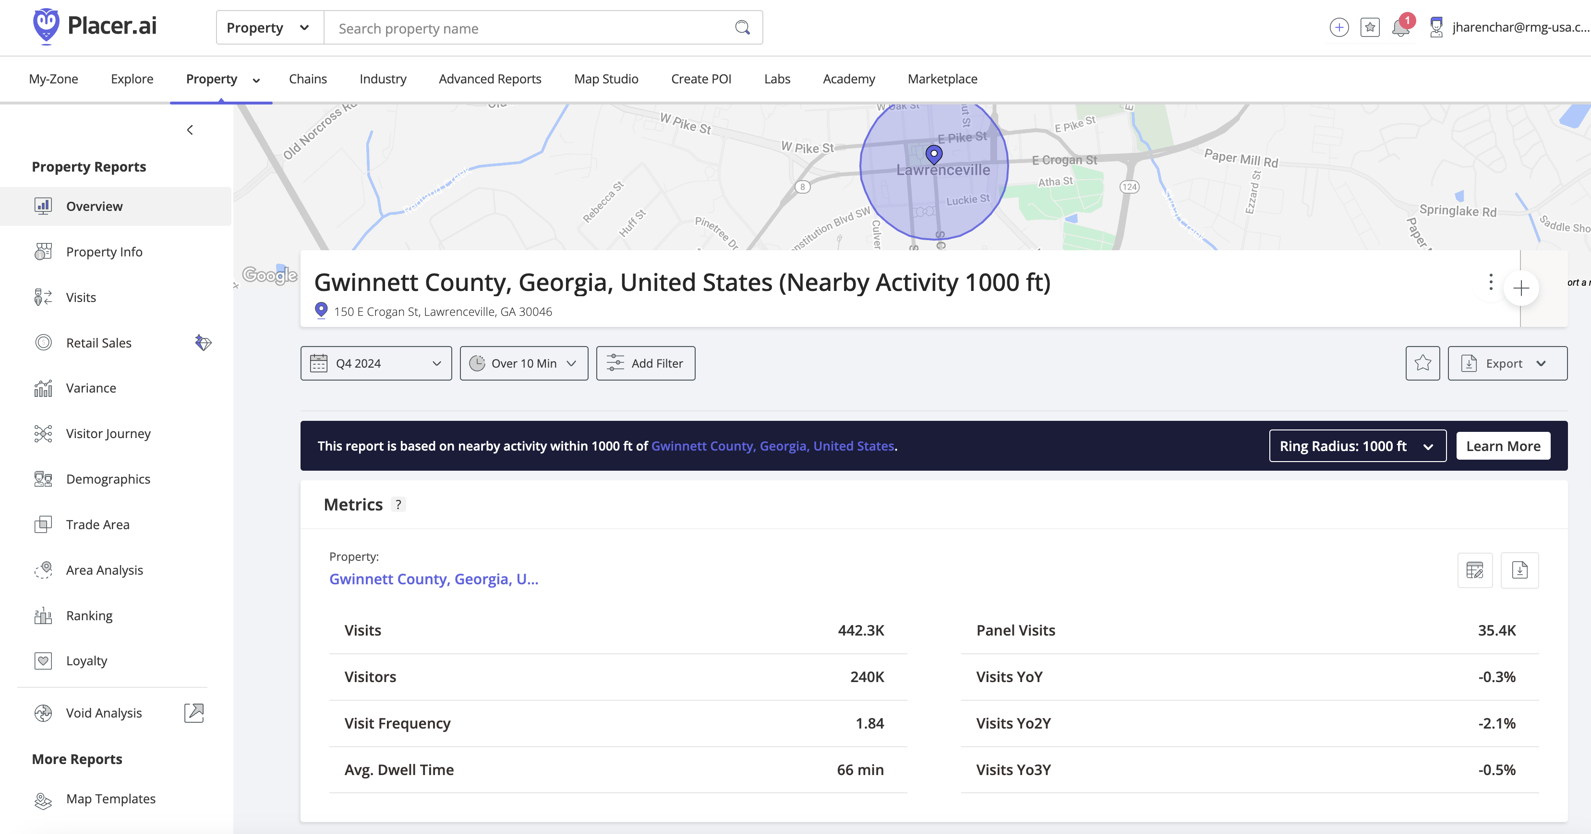
Measuring ROAS – Anonymous Data
Notes:
With anonymous data from sources like Placer.AI, you can measure hundreds of data points that can inform the success of your marketing.

Slide 27
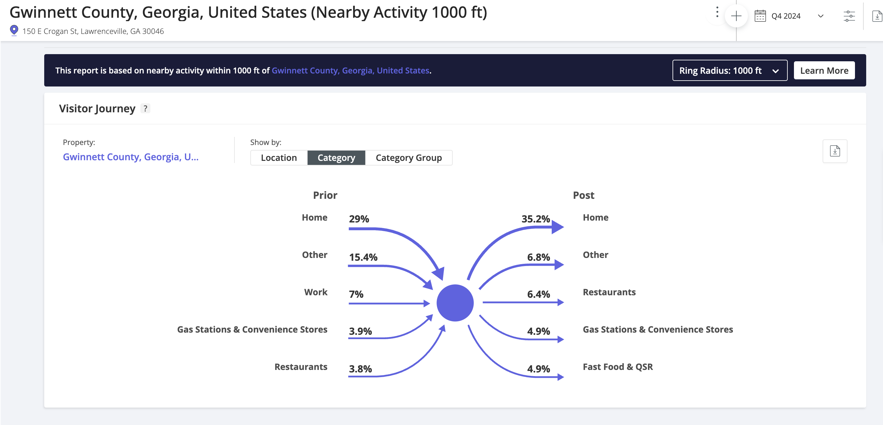
Measuring ROAS – Anonymous Data
Notes:
Learn where your visitors are coming from and where they go when they leave your locations.

Slide 28
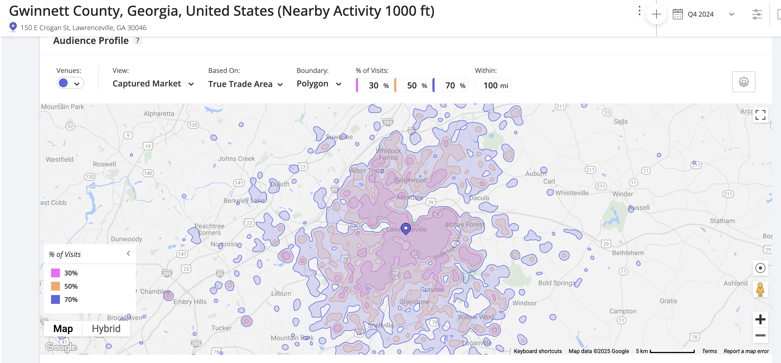
Measuring ROAS – Anonymous Data
Notes:
Measure your Trade Area to understand where your visitors are coming from and where 30%, 50% or 100% of your visitors reside. You can compare month-to-month or year-to-year, looking back up to 3 years. Want to know how a festival or event has performed vs years past, Placer.AI is just 1 tool that can help (and RMG can help you use it).

Slide 29
Visit West Volusia
Notes:
Our client in West Volusia Florida decided to better understand where their visitors were coming from. We did a portrait analysis built on provided data from lodging partners, attraction ticket sales and visitor center requests.

Slide 30
Visit West Volusia
Notes:
We found a very low penetration of the 25-34 age group. This was troubling to many on the Board and the client met with their ad agency to understand what could be done to better market key assets from across the region.

Slide 31
Visit West Volusia
Notes:
Equipped with valuable audience insights, the agency and client developed the Cool Craft Trail – 33 unique stops comprised of breweries, shops, attractions, wineries and more. They launched the Cool Craft Trail landing page and it was a HUGE success, appealing to their target segment.

Slide 32
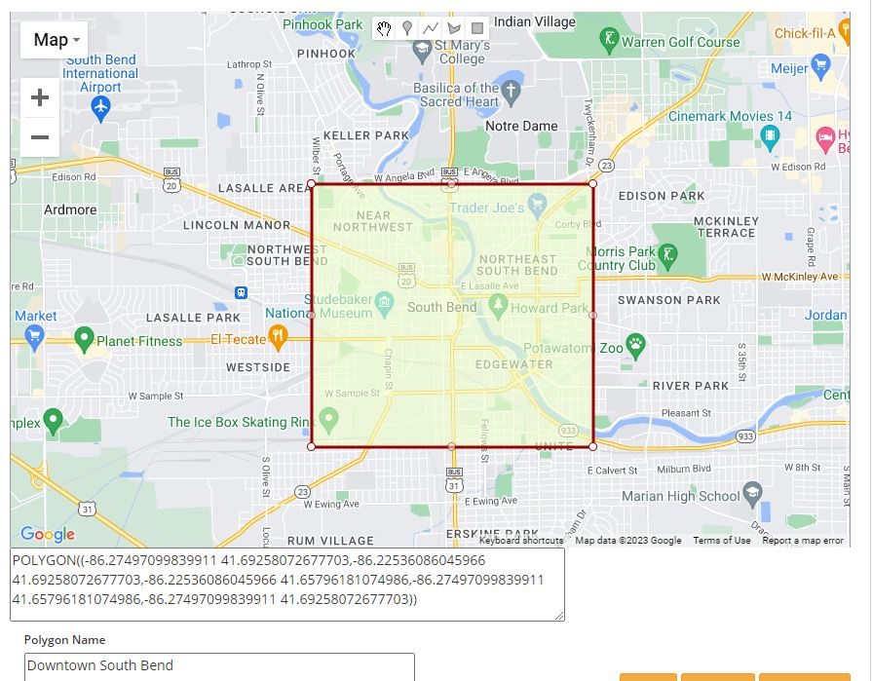
Measuring ROAS – De-Anonymized Data
Notes:
De-anonymized data is normally captured through geofencing or geoframes built around DMO assets; events, attractions, festivals or sporting activities. Using mobile device capture, DMOs can better understand EXACTLY who is in their market.

Slide 33
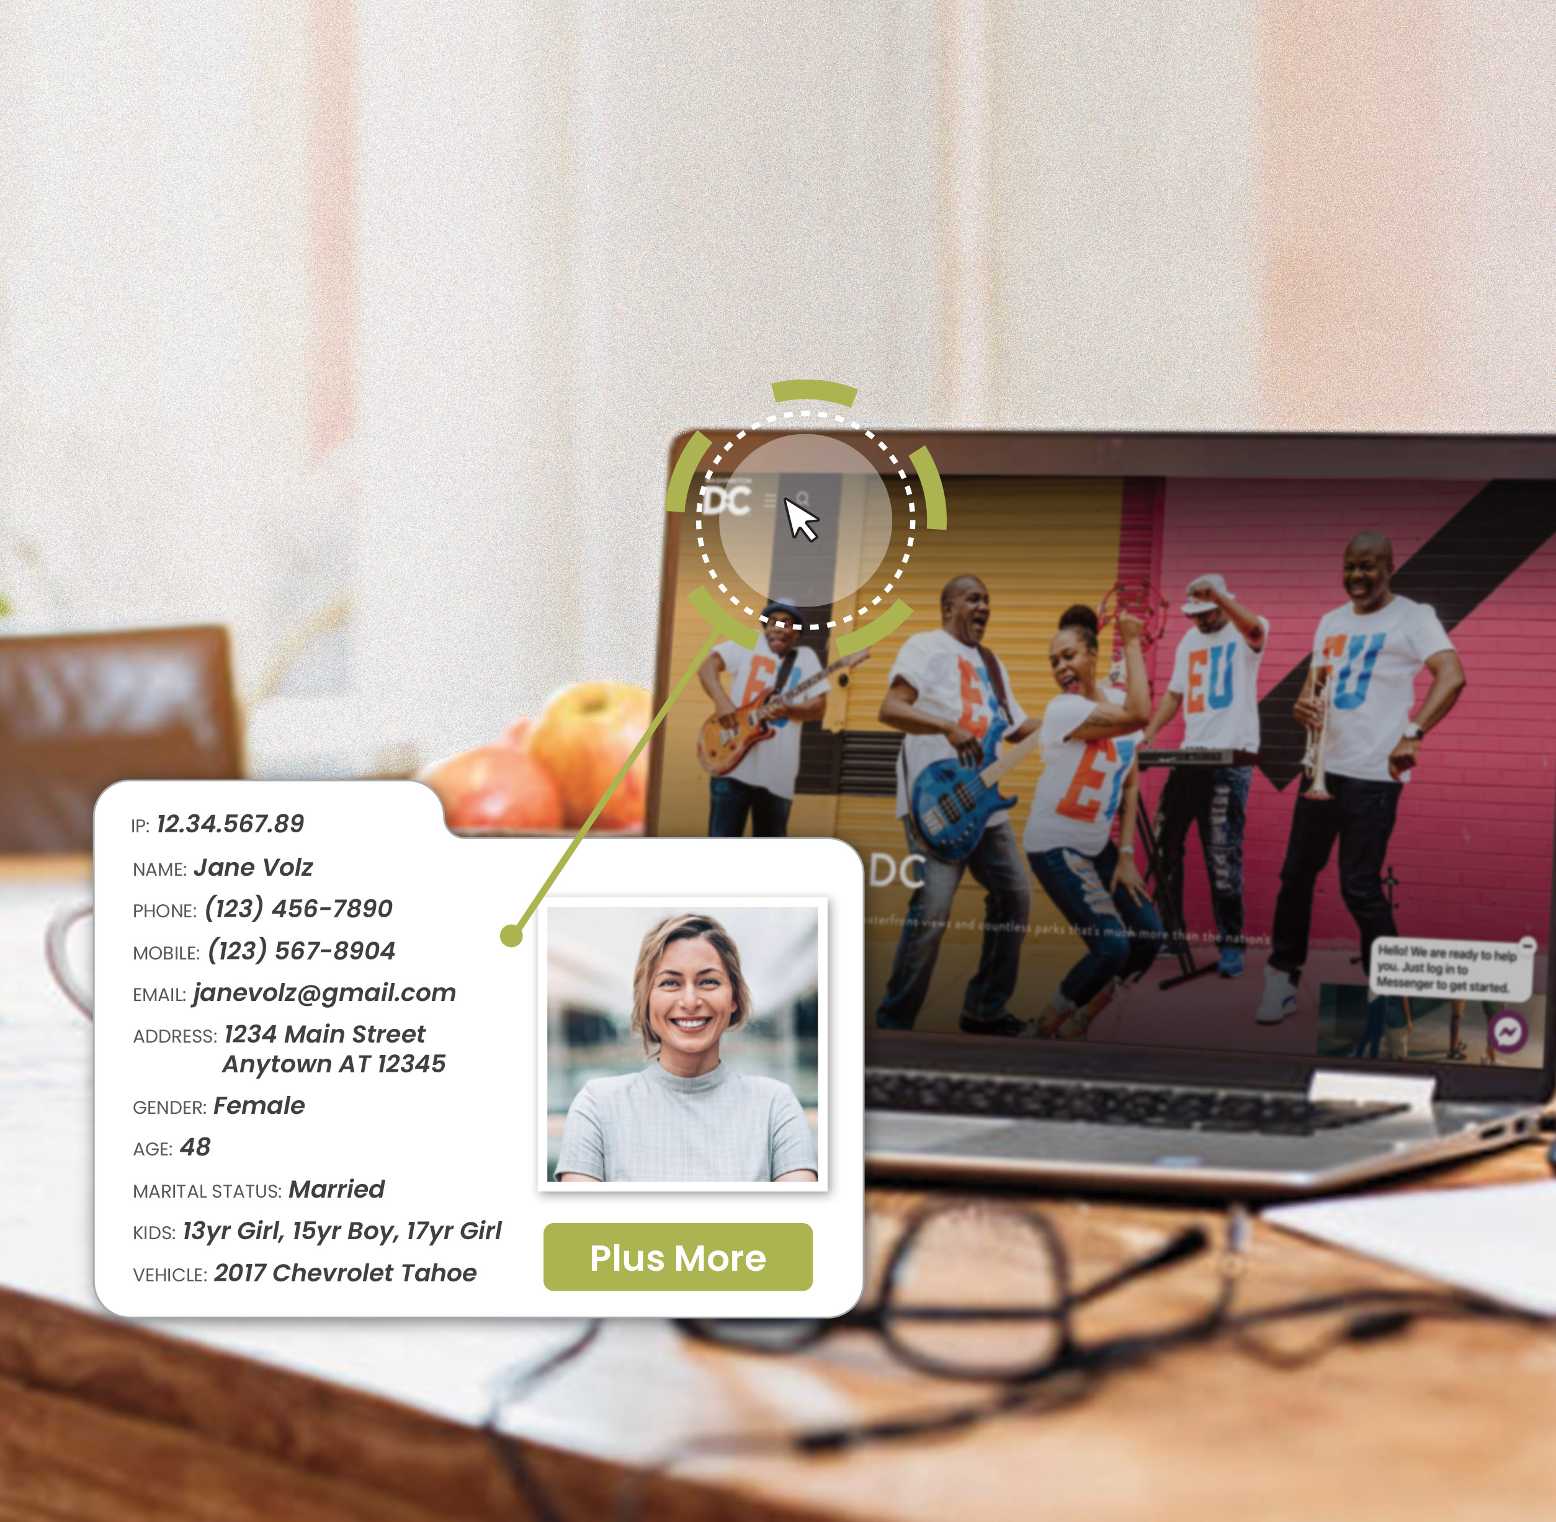
Measuring ROAS – De-Anonymized Data
Using a Cookie to track user behavior
Using an embedded pixel to match IP address
De-anonymize the 95% of site visitors who provide no information
Append demographics and site behavior
Matched ID produces over 300 demographics
Notes:
While cookies are slowly becoming less relevant in data capture, pixels are growing in popularity. By placing a pixel in your website header, you can de-anonymize your website visitor to know EXACTLY who is on your site, what pages they view and validate your ad targeting.

Slide 34
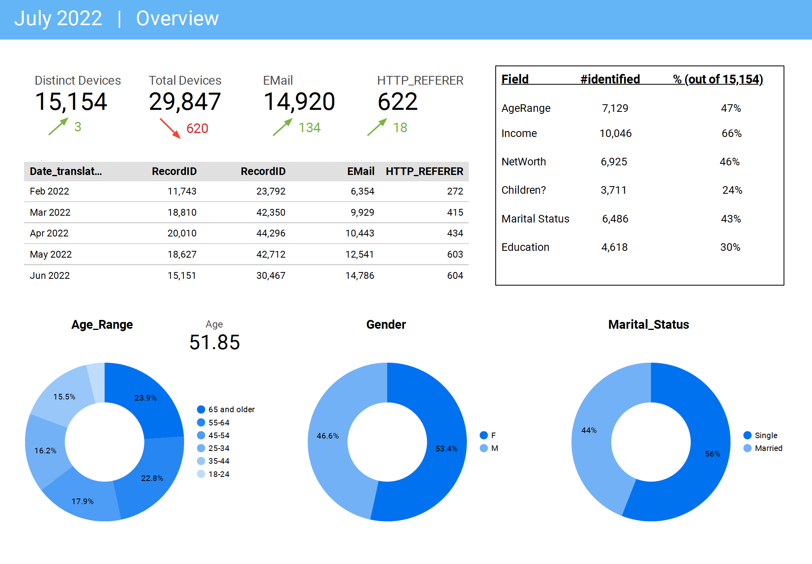
Measuring ROAS – De-Anonymized Data
Notes:
You can measure your site traffic and understand key demographics like age, income, gender, presence of children and over 100 more key elements. You can even append an email on up to 50% of your site visitors for follow-up engagement. All fully compliant!!

Slide 35
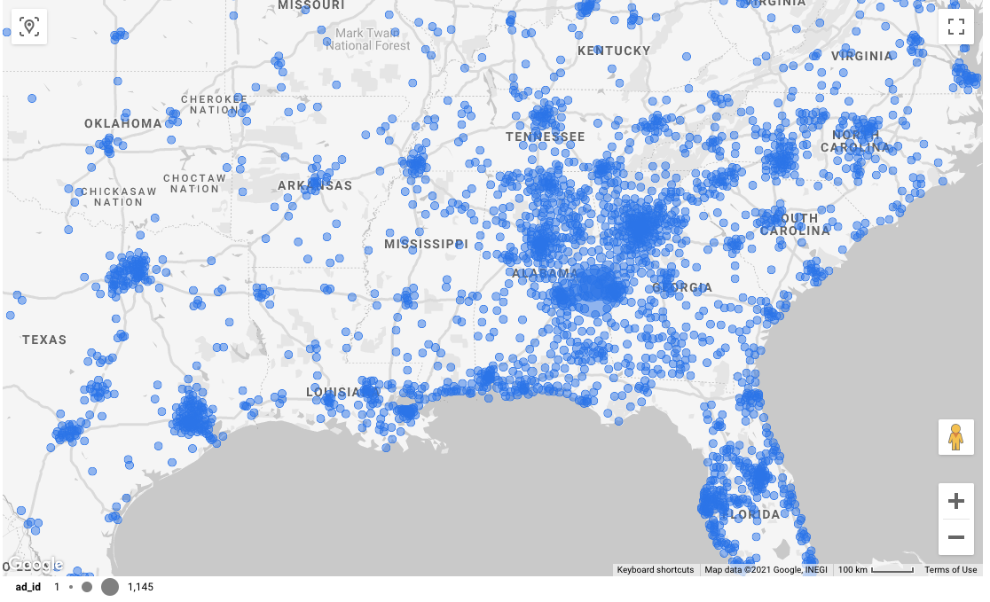
Measuring ROAS – Validate Campaign Performance
Notes:
Stop guessing where you visitors are coming from. While intercept surveys have some value, using de-anonymized data allows you to know EXACTLY where they live.

Slide 36
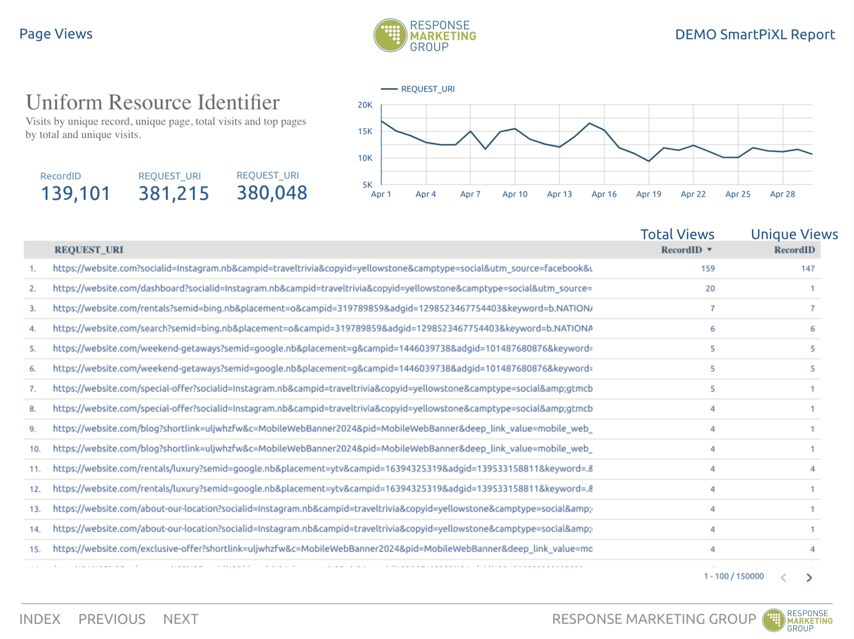
Measuring ROAS – De-Anonymized Data
Notes:
Wouldn’t you like to know what digital campaigns are working and whether your target audience is visiting your website. Now there are tools in the market that can identify what ads your site visitors clicked on to arrive on your website.

Slide 37
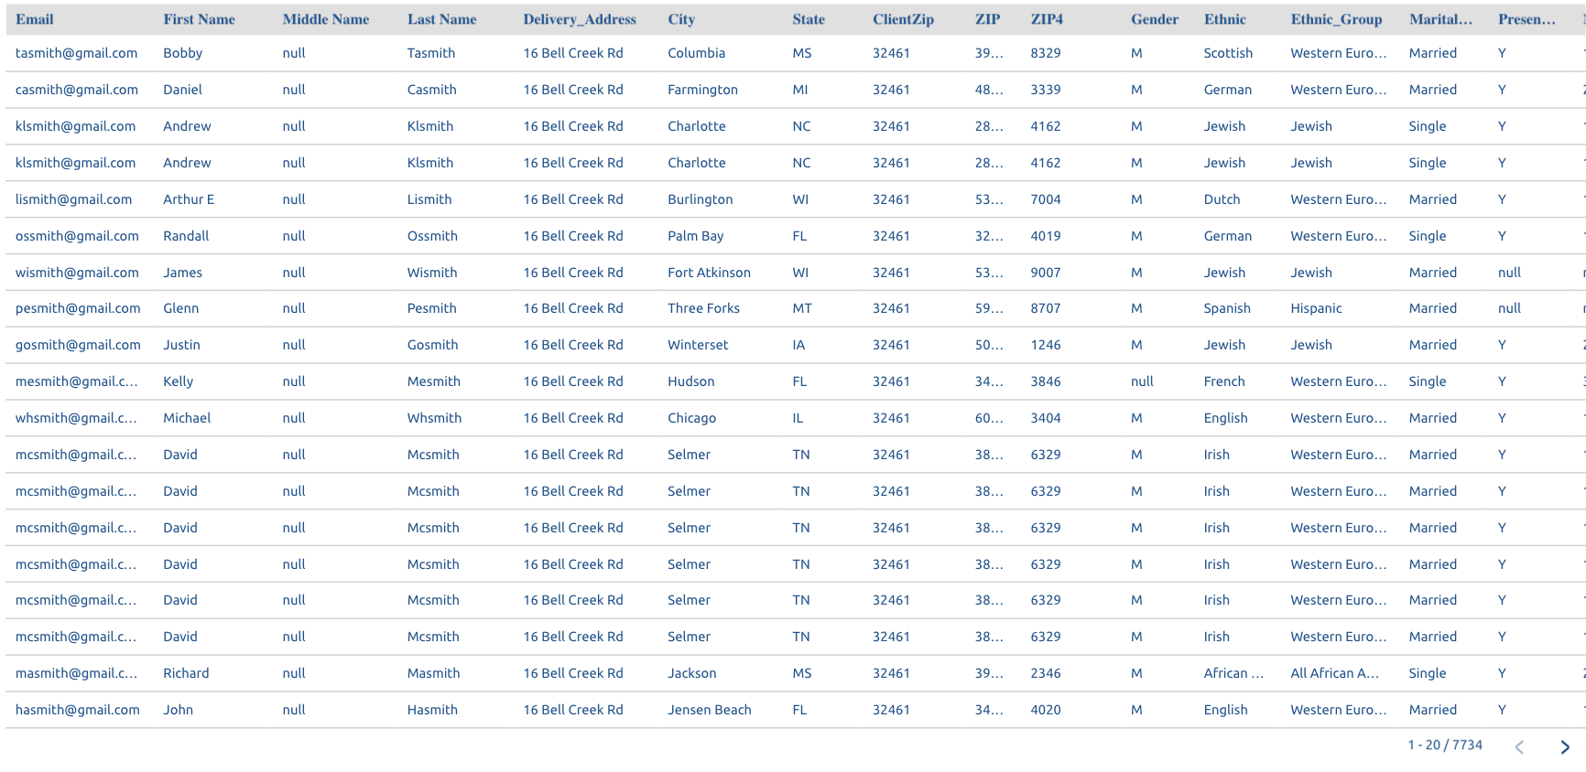
Measuring ROAS – De-Anonymized Data
Notes:
You can even receive detailed reports by name to add into your CRM or visitor data that can be used to follow-up with your visitors.

Slide 38
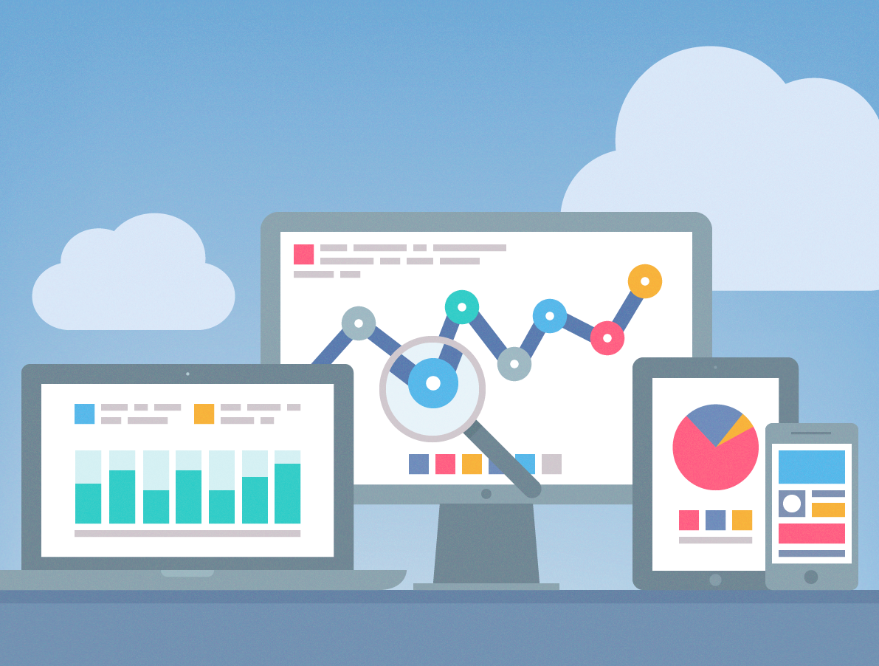
Use Cases
Notes:
Use Cases

Slide 39
Measuring ROAS – Validate Campaign Performance
How Can You Best Use Inquirer/Visitor Data To Help Drive Increased Occupancy and Engagement in 2025?
ID Your Out-Of-Town Visitors vs Locals: More Than 150+ Miles
Who are they? Where are they from?
How much does XXXX impact the reason they come to your market?
What are their behaviors?
Who stays 1 night vs 2 nights or more?
How do we get additional stays/nights?
ID Your “Local” Visitors (>100 Miles)
Who stays 1 night or 0 nights?
How do we get these folks to increase engagement?
What demographic attributes and self-reported interests can I use?
Mining behaviors/interests (dining, golf, hiking, retail/shopping) that we could test?
Partner offers and promotions
Notes:
Don’t let 2025 be yet another year that you didn’t recognize the power of data. Practice a Crawl – Walk – Run approach to using data to improve your marketing and increase your occupancy rates and visitation levels.

Slide 40
Roadmap To Success
The Visitor’s Journey
Radio, TV, Outdoor, Print
CRM/EMAIL
Returns
Home
Gather Input and Information
DISPLAY – CRM TARGETING
Destination/Hotel Experience
Make Decision and Reservation
MOBILE
SITE/EMAIL
Arrival at Location
Plan What to See and Do
SOCIAL
PAID SOCIAL - CRM TARGETING
Get Ready and Make the Trip
REWARDS
PRE-ARRIVAL EMAIL
BOOKING
Notes:
Using a data-driven approach allows you to reach your prospective visitor as they move through their planning process and ultimate decision.

Slide 41
When I Get Back To The Office . . .
Start with a clean data set
01
Use your data to build visitor and inquirer segments by interest and behavior
02
Develop a true response attribution plan to measure ALL of your channels
03
Provide insight and validation to your ownership/funding sources
04
Build Board alignment, attract and retain sponsors and partners by sharing full insight to campaigns, events, results
Notes:
Today is the day to start your data-focused 2025. Here are 5 easy steps to getting your journey started.

Slide 42
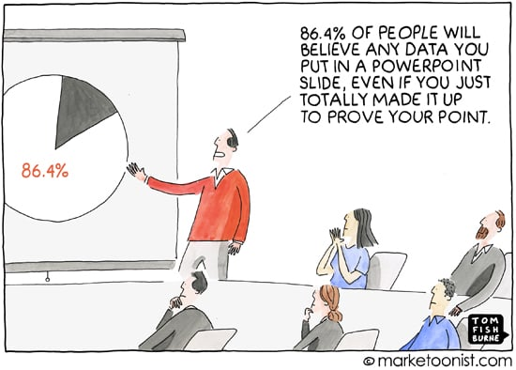
When I Get Back To The Office . . .
Notes:
“86.4% of people will believe any data you put in a PowerPoint slide, even if you just totally made it up to prove your point.”
Thanks for listening . . . And reading!

Slide 43
GACVB
February 4, 2025
Jim Harenchar
Response Marketing Group
www.rmg-usa.com
804-370-1439
jharenchar@rmg-usa.com
Melissa Lewis
Response Marketing Group
www.rmg-usa.com
843-330-8746
mlewis@rmg-usa.com
Notes:
Jim Harenchar
804-370-1439
jharenchar@rmg-usa.com
Melissa Lewis
843-330-8746
mlewis@rmg-usa.com

